Slide 1
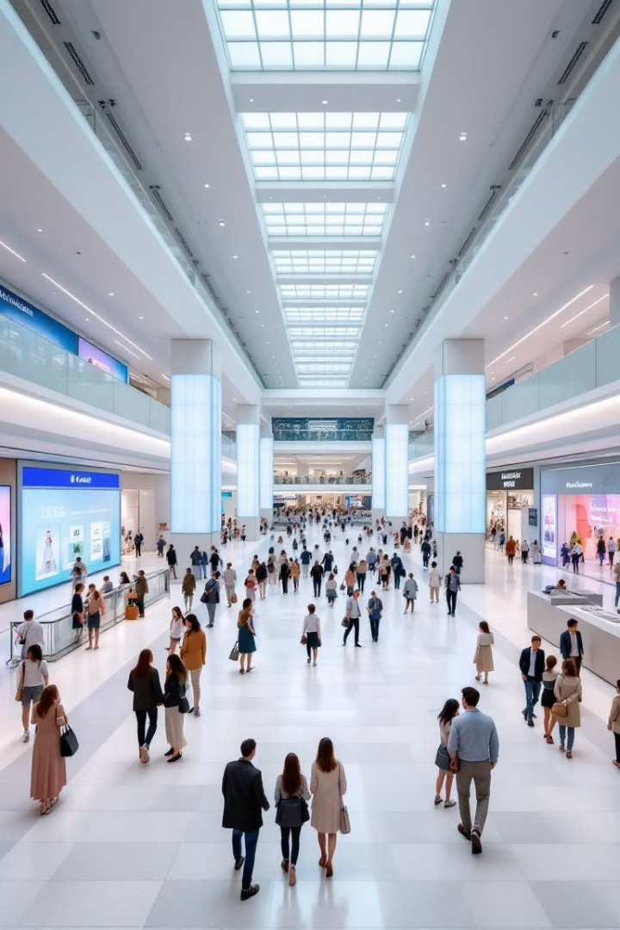
Shopping Mall Management System
Welcome to our Software Engineering project presentation. We're excited to introduce a comprehensive system designed to revolutionize shopping mall operations for both administrators and customers.
Muhammad Shameel
Muhammad Hammad
Anees Ahmed

Slide 2
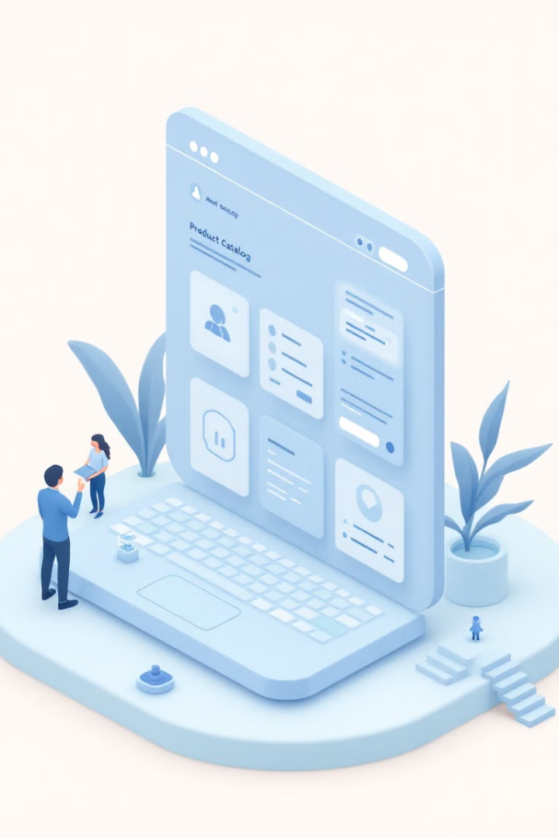
Project Overview
Streamline Operations
Core Features
We offer product browsing, inventory management, sales tracking, and secure admin controls.
Our system aims to simplify and enhance shopping mall management for all stakeholders.

Slide 3




Key Stakeholders
Customers
Browse products, manage carts, and complete secure checkouts with ease.
Administrators
Efficiently manage inventory, sales records, and administrative roles.
Management
Analyze system-generated reports for data-driven decision making.

Slide 4
Project Scope
User Features
Admin Features
Intuitive product browsing and search functionality
Comprehensive product and inventory management
Secure shopping cart management and checkout process
Sales and payment record tracking
Secure admin registration and reporting tools
Detailed billing with accurate change calculation

Slide 5




Functional Requirements
Product Search
1
Efficient browsing and category-based search
Cart Operations
2
Add, remove, and modify items in cart
Secure Billing
3
Encrypted payment processing and receipt generation
Admin Controls
4
Inventory management and sales record access

Slide 6

Non-Functional Requirements
Usability
Performance
User-friendly interface with robust error handling for smooth operation.
Efficient system capable of handling multiple concurrent users without lag.
Security
Scalability
Data protection through secure file handling and access controls.
Flexible architecture allowing for future expansion of users and products.

Slide 7
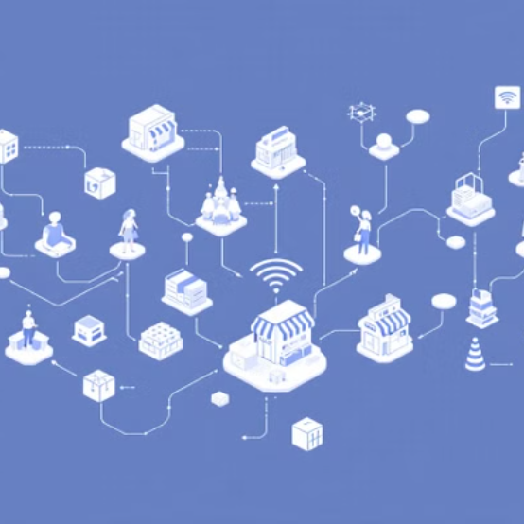
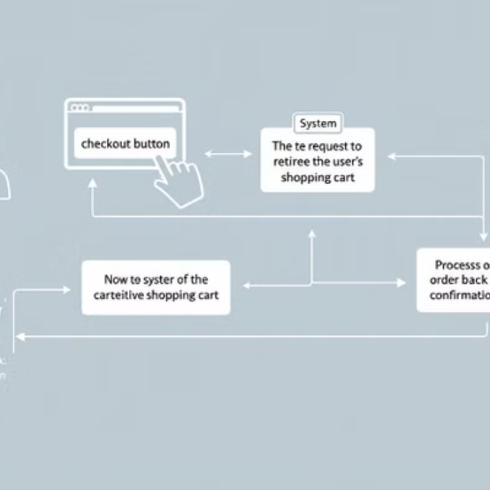
Software Design
Class Diagram Activity Diagram

Slide 8
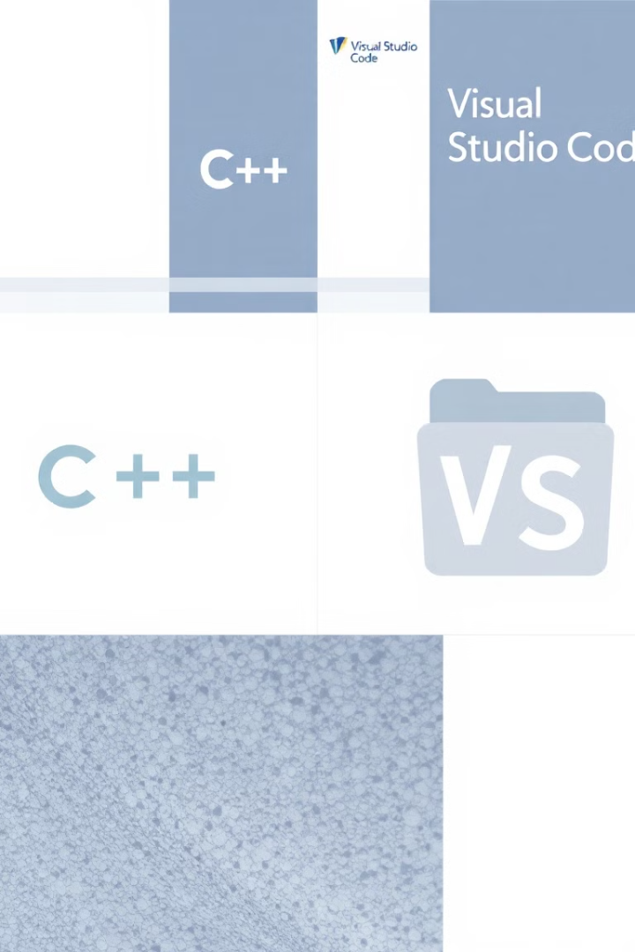



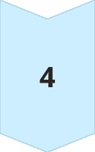
Tools & Technologies
C++ Programming
Core language for system development, ensuring efficiency and control.
Visual Studio Code
Powerful IDE for coding, debugging, and version control integration.
Standard Libraries
Utilizing iostream, fstream, vector, and windows.h for robust functionality.
File-Based Storage
Implementing data persistence through efficient file handling techniques.

Slide 9
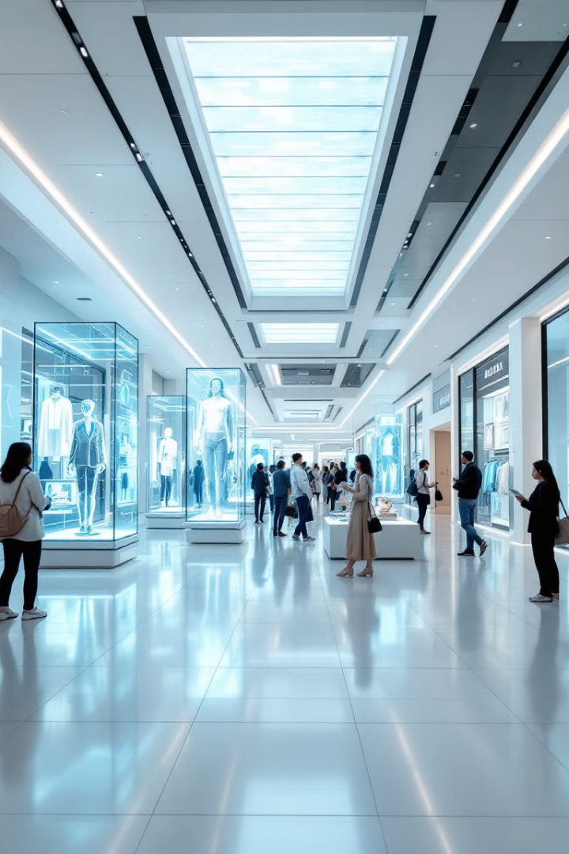
Conclusion & Future Scope
1
Current Impact
Enhancing efficiency in managing complex shopping mall operations.
2
Short-term Goals
Expand functionalities to include more advanced reporting features.
3
Long-term Vision
Integrate a graphical interface and explore mobile app development.

